Slide 1
Comparison Methods 1 Present Worth, Future Worth, Annual Worth & Payback Period
APSC 221 – Week 2
Summer 2024

Slide 2
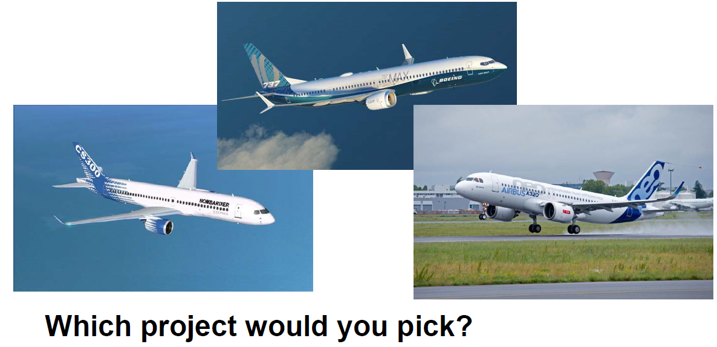

Slide 3
Introduction
Engineers need to be able to determine the feasibility of a project based on the costs and benefits:
Projects are investments, an exchange of resources now for an expected benefit in the future
Not all investments should be taken.
Poor value proposition (costs exceed benefits)
Not all investments can be taken.
Resource limitations

Slide 4
Key Assumptions in Comparison Methods
Costs & benefits are measurable in terms of monetary value
Future cash flows are known with certainty
Cash flows are not affected by inflation (for now)
Taxes are not applicable (for now)
There are sufficient funds available (unless otherwise specified); and
All investments have a first cost / cash outflow to start.

Slide 5
Project Relationships
Independent
- Expected cost/benefit of each project does not depend on whether another is chosen
Mutually Exclusive
- If one project is chosen, all others are excluded
Related, but not Mutually Exclusive
- Expected cost/benefit depend on whether another project is chosen

Slide 6
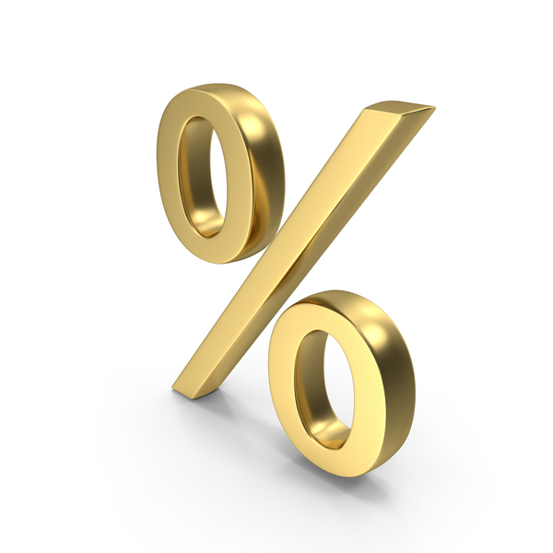
Minimum Acceptable Rate of Return (MARR)
MARR is known as the “hurdle rate” -> the minimum required rate of return
Assume that money can be invested elsewhere and can achieve the MARR (“Do nothing option”).
How do you determine this rate?
Weighted Average Cost of Capital (debt and equity)
Internal and External Rate of Return
Risk Free Rates
Notes:
High risk activities (30+%) – New ventures, new products
Moderate risk (15-25%) – Increasing capacity to meet forecasted demand
Low risk (10-15%) – improvements to meet current demand

Slide 7
Comparison Methods
Present Worth Method (PW)
Future Worth Method (FW)
Annual Worth/Annual Cost Method (AW/AC)

Slide 8
Evaluation Criteria
PW/FW Methods
Independent Projects
PW < 0, PW = 0, PW > 0
Mutually Exclusive Projects
Maximize PW
AW/AC Method
For profits, maximize AW
For costs, minimize AC
MUST HAVE SAME LIFESPAN

Slide 9
Example – Independent PW
Aurora Air wants to open a temporary base in Sweden. The initial startup costs are expected to be $100,000 and will yield $53,100 annual revenues for 5 years. Maintaining the base will cost $30,000 per year and they expect to recover $20,000 when they close the base.
If Aurora Air requires a 10% per year return, is this a desirable project?
Notes:
PW = -100k + 53.1k (P/A,10%,5) – 30k (P/A,10%,5) + 10k (P/F,10%,5) = $-14.52
Essentially breakeven, so minimally viable

Slide 10
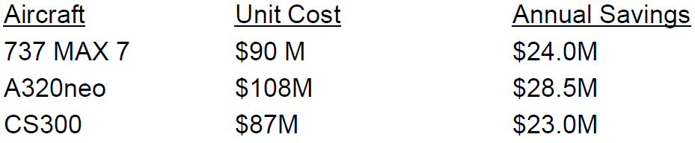
Example – Mutually Exclusive PW
Aurora Air wants to replace its fleet of aircraft at the temporary base. The following 3 options were provided to them:
Assuming the same required return and time period as the temporary base, which aircraft should they choose?
Notes:
PW = -UC + AS (P/A,10%,5)
B737 = $0.979M
A320 = $0.038M
CS300 = $0.188M

Slide 11
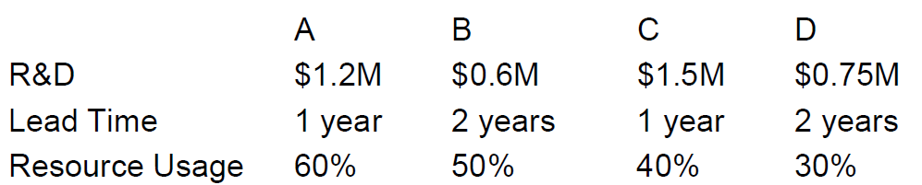
Example – Related, but not M.E.
Herring Electronics wants to introduce new products to the market within 2 years. They have an R&D budget of $3M, but also a directive to spend at least $2M. The company has limited labour resources, so their projects cannot exceed their capacity.
Which products should they develop?
Notes:
>$2M means multiple projects required, at least 2, some 3 projects (AB, AD, BD combinations)
<$3M means combination of: 1) A, B, D; 2) A, C; or 3) B, C, D
Below 100% capacity: 1) not possible; 2) yes start A and C in separate years; 3) not possible
Pick A and C

Slide 12
Uneven Lifespan
If the service lives of projects are not the same, transform them into equal lives:
Repeated Lives Approach
In this method, repeat the project lives to the lowest common denominator (within reason)
Study Period Approach
Determine a specified study period and realize a salvage value at the end of the study.
Requires that the costs/benefits are reasonably well distributed.

Slide 13
Example – Uneven Lifespan
A plant has brass fittings which last 3 years and cost $1200 and stainless-steel fittings which last 4 years and cost $1500. Neither has a salvage value, and the required interest rate is 8%
Which is the more cost-effective fitting?
IS THERE A SMARTER WAY THAN THIS?
Notes:
LCD = 12 -> brass 4 cycles, steel 3 cycles
Brass PW = -$1200 (1+(P/F,8%,3)+(P/F,8%,6)+(P/F,8%,9)) = -$3.5k
Steel PW = -$1500 (1+(P/F,8%,4)+(P/F,8%,8)) = -$3.4k
Steel has lower present cost

Slide 14
Annual Worth/Annual Cost for Uneven Lifespan
Rather than defining specific time horizons to make a comparison, we can implicitly use AW/AC method:
Relying on the assumption of mathematical equivalency
If there are identical repetitions, the AC is the same for any integer of multiples of its life
This method is much easier to compare annuities than present worth
Remember, “annual worth” can also be applied to periods different than a year (ie, month), when necessary
Robustness of the AW/AC method
Although cash flows may change over time (inflation), these changes are heavily discounted due to the time value of money, so the AW/AC method can provide a good estimate for evaluations

Slide 15
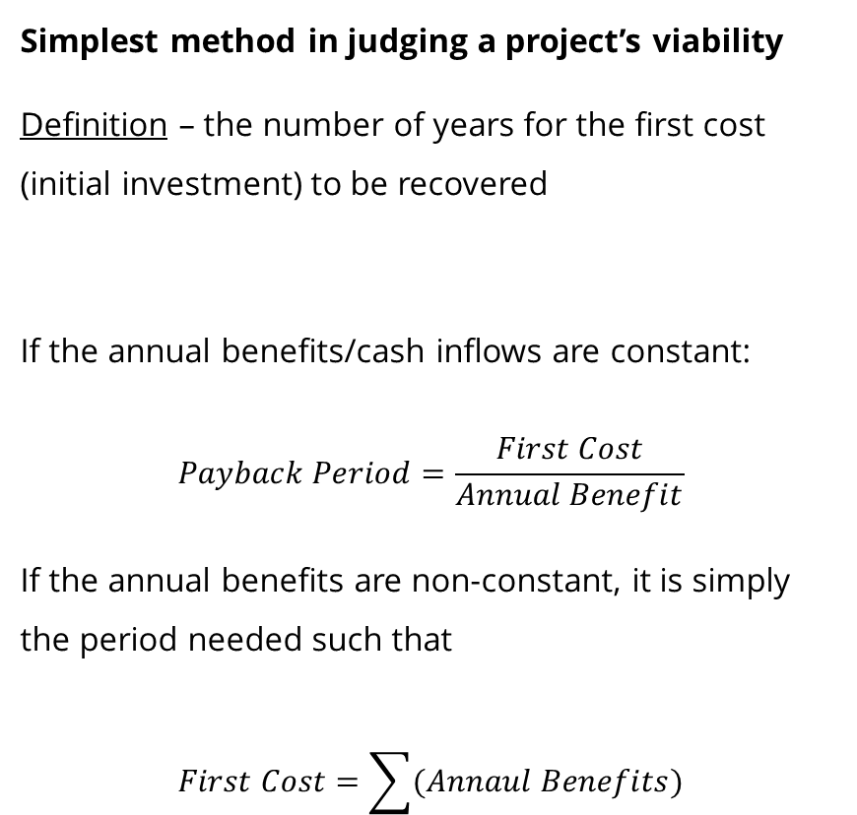
Payback Period
Simplest method in judging a project’s viability
Definition – the number of years for the first cost (initial investment) to be recovered
If the annual benefits/cash inflows are constant:
$$Payback Period=\frac{First Cost}{Annual Benefit}$$
If the annual benefits are non-constant, it is simply the period needed such that
$$First Cost=\sum{(Annaul Benefits)}$$
General Evaluation Criterion
Independent Projects
“hurdle” period of 2 – 4 years
Mutually Exclusive Projects
Minimize the payback period

Slide 16
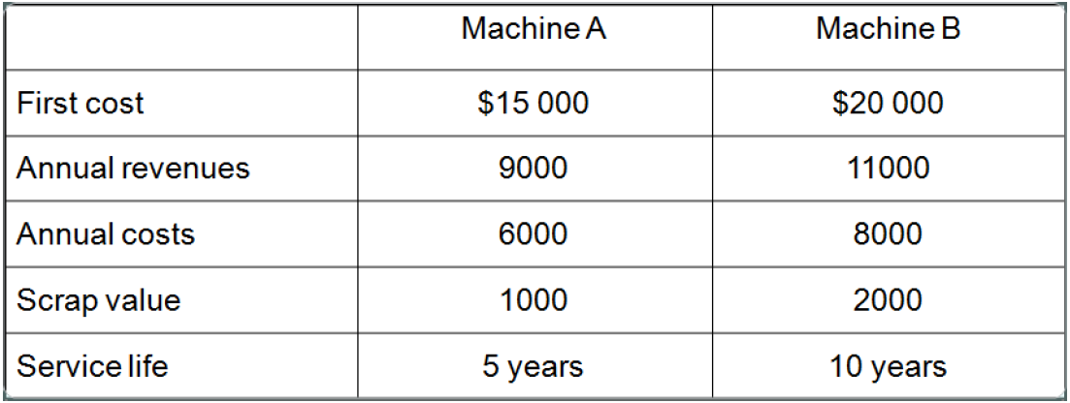
Example – Payback Period
Of the 2 opportunities below, what is the payback period for each and what would be the recommendation?
This is a very crude method. It is easy to understand but ignores the fundamentals of interest and time value of money.
YOU SHOULD NEVER USE PAYBACK PERIOD AS THE SOLE DETERMINATOR FOR A PROJECT’S VIABILITY
Notes:
A = 15k/(9k-6k) = 5 years
B = 20k/(11k-8k) = 6.67 years
Neither

